Slide 1
Kick-Off
Crowdstrike EDR
Sep / 2023

Slide 2


Background – Cybereason VS Crowdstrike
Cybereason is not powerful and even led to incident in production.
Lack of the operation
Unreliable instance performances
Poor device controls.
Decentralized setup disallowing us for delivering managed detection and response service.
Full EDR prevents silent failure by capturing raw events for complete visibility
Unparalleled coverage defends against all types of attacks from malware to the most sophisticated and stealthy nation-state attacks
Speed investigations and act fast with intelligent prioritization and powerful Incident Workbench
Continuous raw events capture empowers proactive threat hunting
Threat intel integration, automated IOA remediation, and powerful real-time response capabilities speed up investigation and remediation and enable deep understanding of the attacks in your environment
24/7 managed threat hunting ensures stealthy attacks don’t go undetected
VS

Slide 3
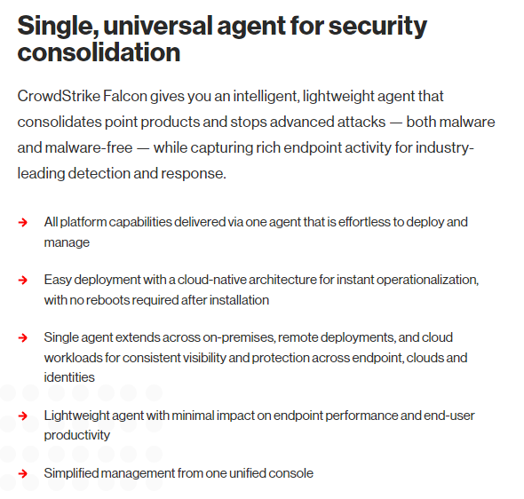
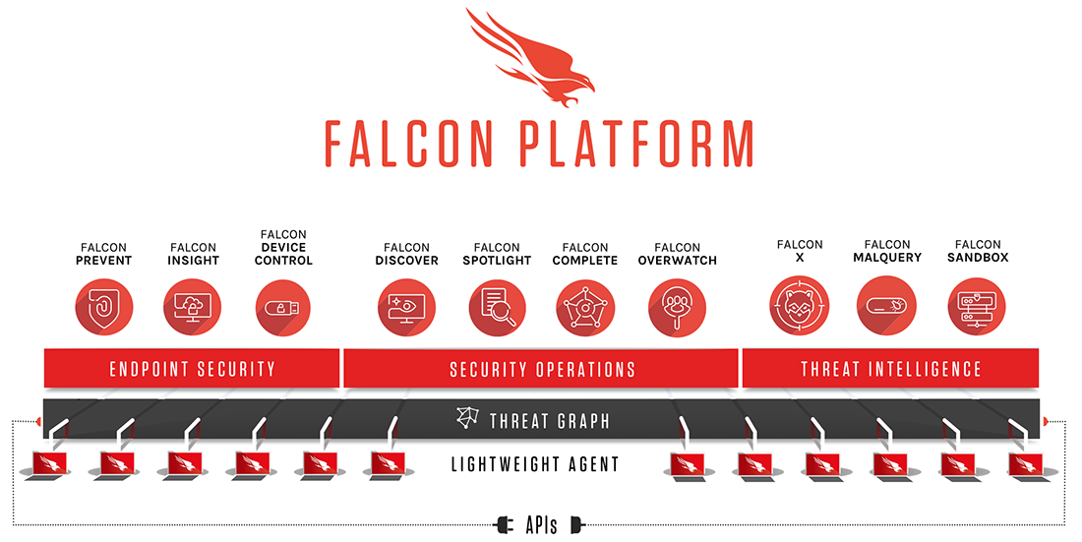
Crowdstrike Falcon Platform
CrowdStrike Falcon Endpoint Protection
https://www.crowdstrike.com/falcon-platform/

Slide 4

Architecture Layer
Group CSec
Global Monitoring
Policy Enforcement
Group Level
Policy Enforcement
Asia Zone Level
Regional Dashboard
Regional Monitoring / KPI / Security posture
Asia CSec
Threat Detection and response
China
Taiwan
Japan
SEA
India
S.Korea
HongKong
each BU local team
Endpoint Management & Remediation
Admin & Mgmt Console
Project JV
Group / Tag
Project JV
Group / Tag
Project JV
Group / Tag
Project JV
Group / Tag
Project JV
Group / Tag
Project JV
Group / Tag
Project JV
Group / Tag

Slide 5
Function Structure Map
Group Level
Asia Level
BU Level
Group Dashboard
Regional Dashboard
Endpoint management
Phase #1
Talent management
KPI management
Next Gen AV/EDR
Phase #1
Phase #2
Policy Enforcer
Security Posture
Policy Delivery
Phase #1
Phase #2
Incident management
Phase #1
Now we are focusing on Phase#1
Enable AV/EDR with assets
Enable Alert Detection/ Remediation

Slide 6
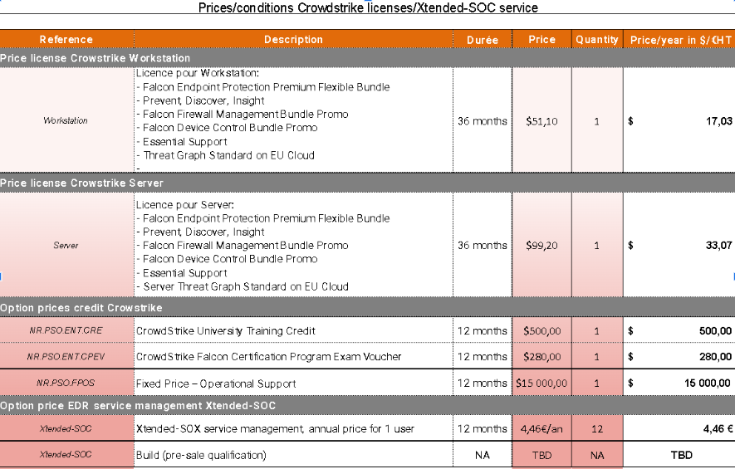
Crowdstrike Falcon Platform
https://www.crowdstrike.com/products/

Slide 7
Migration – Roadmap Asia Phase#1
Status
Group CSEC has confirmed Crowdstrike as our new EDR solutions with the pricing info.
Number of subscriptions of BUs has been collected and CrowdStrike Subscription List had been completed by BUs.
Next Step
Set up contact with OCD to get PO ready
Release tenant while Procurement
A pilot program will be started in Early Oct.
Here!
2023.8 – 2023.9
Preparation
2023.10 – 2023.11
Pilot Enabled
2023.11 – 2023.12
BUs On Boarding
2023.12 – 2024.1 Troubleshooting & Optimization
2024.2 (2nd Half)
Policy Enforcing
Confirm CrowdStrike as a replacement of Cybereason.
Collect subscription count for each BU.
Commercial Define
Working with OCD/Group/CrowdStrike to have a test Pilot in each Tenant
BUs start to deploy the crowdstrike on their assets.
Troubleshooting issue submitted from Bus.
Secure all the projects from each BU will be completed successful deployed new EDR solutions.
Deploy policies to subscriptions and check policy enforcement.
Optimize policies.

Slide 8
Do and Do Not
Do not deploy Cybereason for new onboarding asset
Do not renew Cybereason licenses
Get ready for the subscription list for entity and BU
Prepare the PO with OCD
Assign the team members who will support CrowdStrike deployment
Continue operating Cybereason until CrowdStrike totally online
❌
✅

Slide 9
People – RACI
BU | Contact
China & Macau | oscar.law@veolia.com philip.tam@veolia.com wilson.ho@veolia.com ronald.lao@veolia.com
HongKong | alex.ho@veolia.com gary.lo@veolia.com
India | rahul.tomer@veolia.com sanjeev.ludhani@veolia.com
Japan | alexandre.carneiro@veolia.com louis.nguyen@veolia.com
Korea | dongsik.oh@veolia.com
SEA | ivan.chua@veolia.com
Taiwan | william.huang@veolia.com joy.liao@veolia.com walker.huang@veolia.com
 | Contact
Group | sarah.loukhmi.ext@veolia.com
Vendor OCD | jean.granger@orange.com
Crowdstrike | julie.salle@crowdstrike.com flavien.moutardier@crowdstrike.com
Asia CESC | wujia.zhou@veolia.com weijia.sun.ext@veolia.com chenyi.linghu.ext@veolia.com nico.zheng.ext@Veolia.com Ben.zhao.ext@Veolia.com Walt.pu.ext@Veolia.com Maggie.wang@Veolia.com
GSOC | sarah.loukhmi.ext@veolia.com

Slide 10
Falcon RACI
To assign some users who necessary take action of investigation and remediation on Falcon RBAC Access of Falcon
BU | Email of assigned Falcon access role
China ML & Macau
China HQ
Hong Kong
India
Japan
Korea
SEA
Taiwan

Slide 11
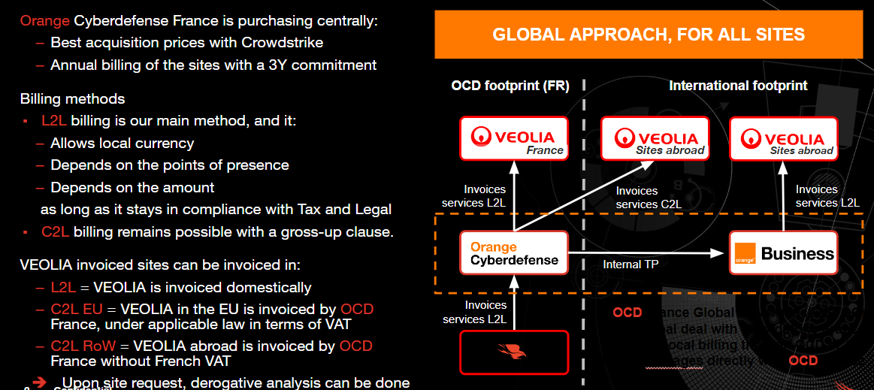
Procurement
Cybereason license status and CrowdStrike
Crowdstrike EDR subscription number collection
OCD will assign the contract and provide billing & invoices from BU & Entity level (Entity level have additional charge)
For Mainland China and Macau, local agent will cooper with OCD to issue contract and billing/invoice(additional taxed charge)

Slide 12

Documents
Technical Documents
Deployment Guide files
Crowdstrike university
Vulnerability Management Ticketing Workflows
Vulnerability Management Overview
Vulnerability Monitoring
Installed Patch Monitoring
Patch Windows Hosts

Slide 13

Key interface role
Technical part from Veolia Group
sarah.loukhmi.ext@veolia.com
Commercial part from OCD
jean.granger@orange.com

Slide 14
Commercial Q&A
NO. | Question | Answer
1 | Whether the 3 years contract with Crowdstrike will be paid annually or have to settle by 2024? If later, the amount # of CW changed, how to deal with it? | The 3 years contract will be paid annually.
2 | This is Financial issue in Asia, can we confirm the contract state of 3 yrs and payment issued annually? | Yes, the contract is for 3 years and the payment is issued annually.
3 | Billing/ invoice issues for each entity under each BU. | Due to the different commercial issues of each BU. Each BU contact OCD and OCD will provide every BU with solutions respectively for Billing/ invoice issues. To breakdown with entity level, it will additional USD1,000 for each entity which want to assign the contract and billing

Slide 15
Technical Q&A
NO. | Question | Answer
1 | Pilot and verification of functions and networking in each BU, and subsequent testing in each BU must be done before deployment. | For your information, Cybersecurity group recommends deploying a pilot before generalizing the deployment so you can perform all the testing and verification needed.
2 | Backbone traffic and bandwidth China <-> International, the forecast bandwidth for amount of traffic. （Cina 'GFW' will be our performance gap） | CrowdStrike is not working with signatures, Instead it is using machine learning. So footprint of Network bandwidth is very low compared to Cybereason, or Kaspersky (earlier). You can choose not to upgrade the agent from the SaaS platform and deploy through your standard tools or you can reduce the bandwidths usage, meaning you will limit the number of agents downloading the new version at the same time. Also, CrowdStrike do have mechanisms to reduce the bandwidth usage if required for agent upgrade.
3 | Should each BU be deployed on an independent portal, or should the deployment be centralized on one portal? How can all tenants be managed centrally? Can we manage all the Asia tenants on a same portal? | ASIA CSEC will be the secondary parent with only viewer access So ASIA CSEC can see all the information in each portal But can't manage them from ASIA CSEC The people from ASIA CSEC need to have an administrator account in each portal to manage them But the CID will be different from a portal to another CID = ID of the tenant So when you want to deploy a sensor in a machine, you use the CID To tell the CrowdStrike sensor to go to a certain tenant And in that tenant, you will have multiple groups. A group for each project You have one team that will handle CrowdStrike for China mainland + HQ and HK It's better to only have one tenant, not three Because since you will deploy all China (mainland, HQ and HK) by the same people And you will apply the same policy it's not interesting to have multiple tenants You will need to do the actions multiple times for each tenant.

Slide 16
Thank you
Sep / 2023

